Slide 1
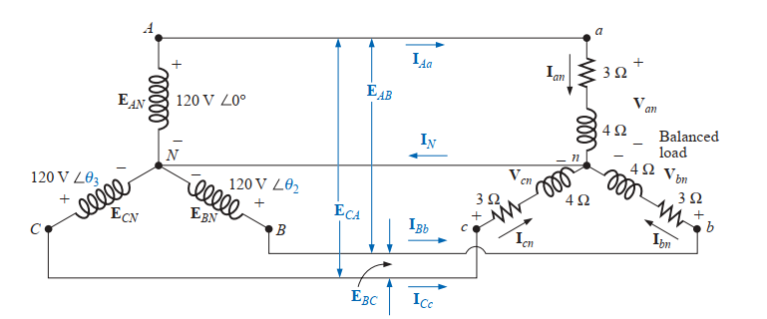
The phase sequence of the Y-connected generator is ABC. Then find:
a. Find the phase angles Θ₂ and Θ₃. b. Find the magnitude of the line voltages. c. Find the line currents.
Θ₂ = - 120° and Θ₃ = 120°
E_{AB} = E_{BC} = E_{CA} = 208 V
I_{Aa} = I_{an} = 24 A , -53.13° I_{Bb} = I_{bn} = 24 A , -173.13° I_{Cc} =I_{cn} = 24 A , 66.87°

Slide 2
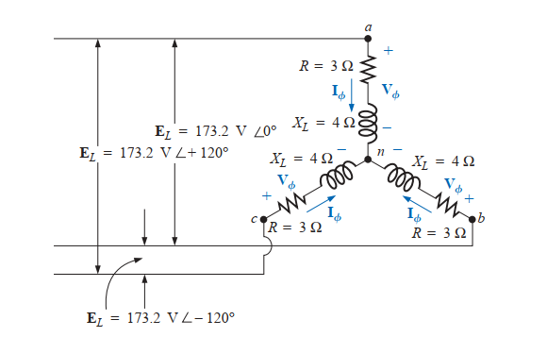
2. For a star connected balanced load, find the following:
a. Find the average power to each phase and the total load. b. Determine the reactive power to each phase and the total reactive power. c. Find the apparent power to each phase and the total apparent power. d. Find the power factor of the load
P per phase: 1200W, Pt = 3600W
Q per phase: 1600 VAR, Qt = 4800 VAR
S per phase: 2000VA, St = 6000VA
Power factor = 0.6 lag

Slide 3
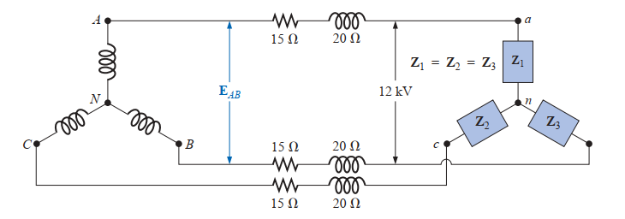
3. Each transmission line of the three-wire, three-phase system has an impedance of 15 + j 20 Ω. The system delivers a total power of 160 kW at 12,000 V to a balanced three-phase load with a lagging power factor of 0.86. find a. Determine the magnitude of the line voltage E_{AB} of the generator. b. Find the power factor of the total load applied to the generator.
E_{AB} = 12358.26 V
Pf = 0.856

Slide 4
4. A balanced three-phase system with a line voltage of 300 V is supplying a balanced Y-connected load with 1200 W at a leading PF of 0.8. Find the line current and the per-phase load impedance.
Line current = 2.89A
Zp = 60 Ω, -36.9◦

Slide 5
5. A balanced three-phase three-wire system has a Y-connected load. Each phase contains three loads in parallel: -j100Ω, 100 Ω, and 50 + j50 Ω. Assume positive phase sequence with Vab = 400,0◦ V.
Find (a) V_{ph}; (b) I_{ph}; (c) the total power drawn by the load.
V_{ph} = 231 V, -30º
I_{ph} = 4.62A , -30º
P = 3200W

Slide 6
6. A balanced three-phase three-wire system has a line voltage of 500 V. Two balanced Y-connected loads are present. One is a capacitive load with 7 - j2 per phase, and the other is an inductive load with 4 + j2 per phase. Find
the phase voltage;
the line current;
the total power drawn by the load;
the power factor at which the source is operating.
289 V; 97.5 A; 83.0 kW; 0.983 lagging.

